Slide 1
Comparison between 6x6 Dynamics and 3x3 dynamics

Slide 2
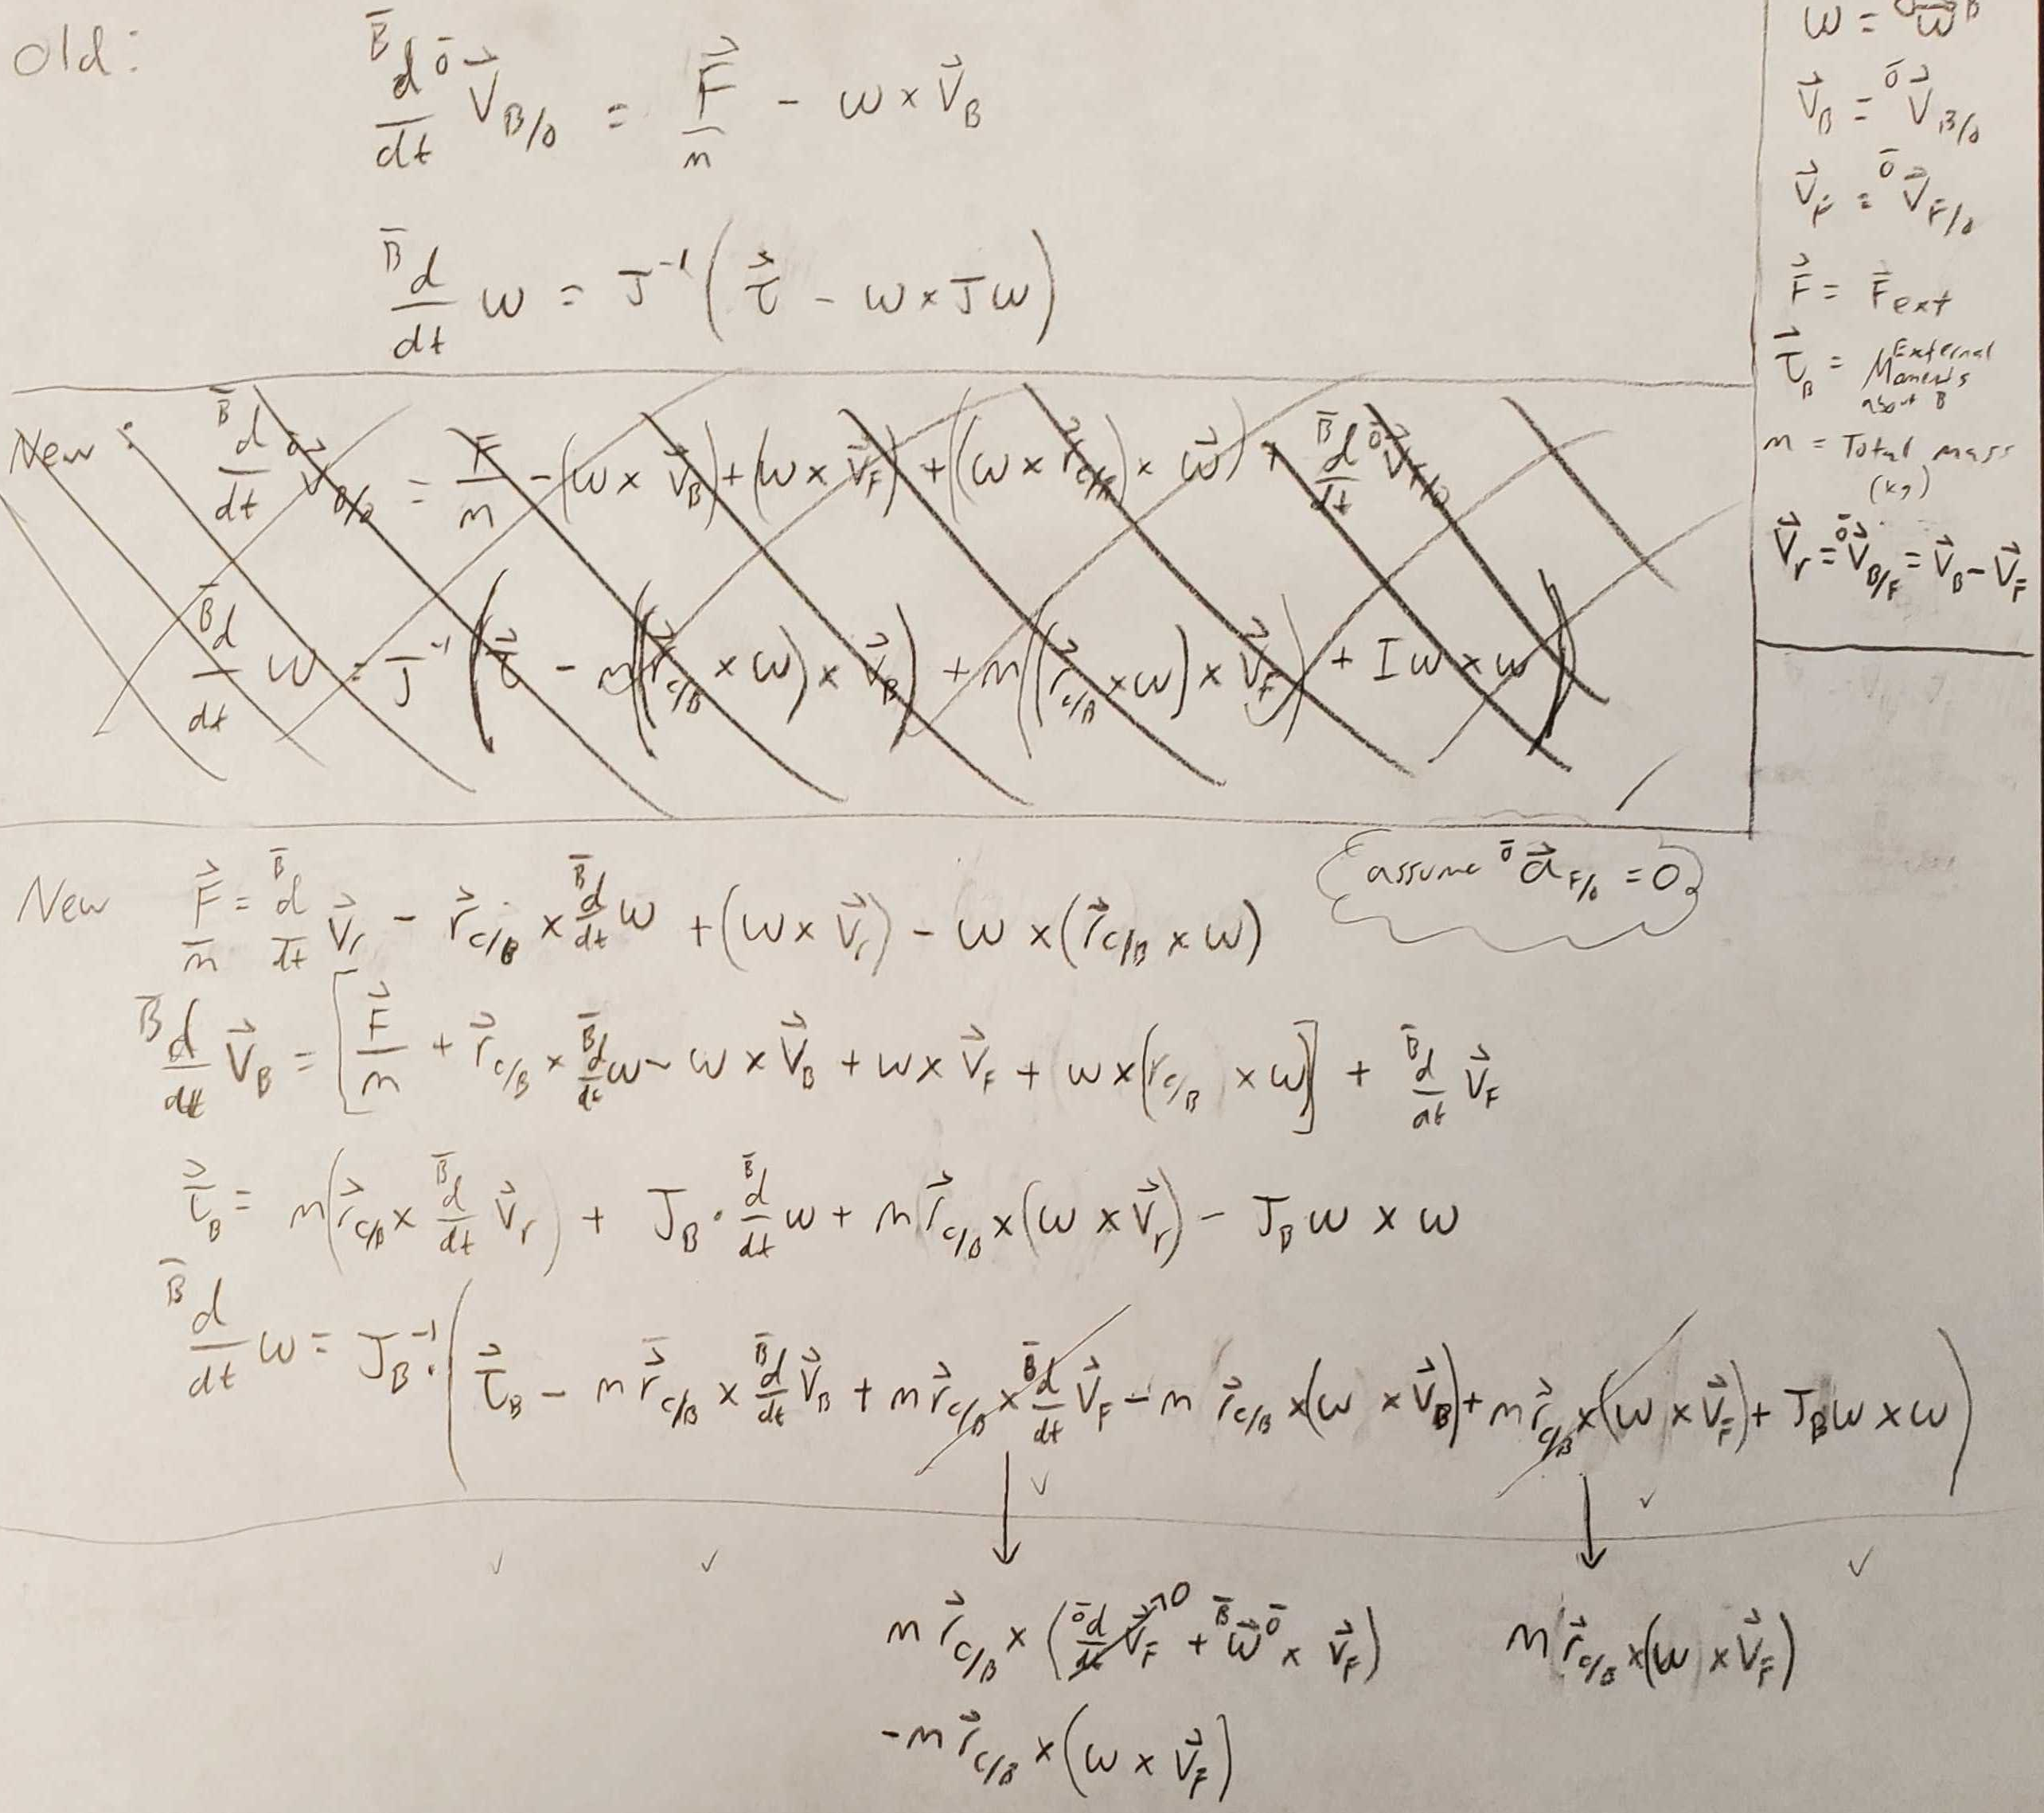
Dynamics as Implemented in Simulink
Old dynamics do not account for distance between the center of mass and the origin of the body frame.
New dynamics have been split up between linear and rotational, but are implemented as coupled equations.
These cancelling terms are implemented, but have no effect on the dynamics. They are a product of using relative flow as a state, which is necessary for the implementation we’re using for added mass.

Slide 3
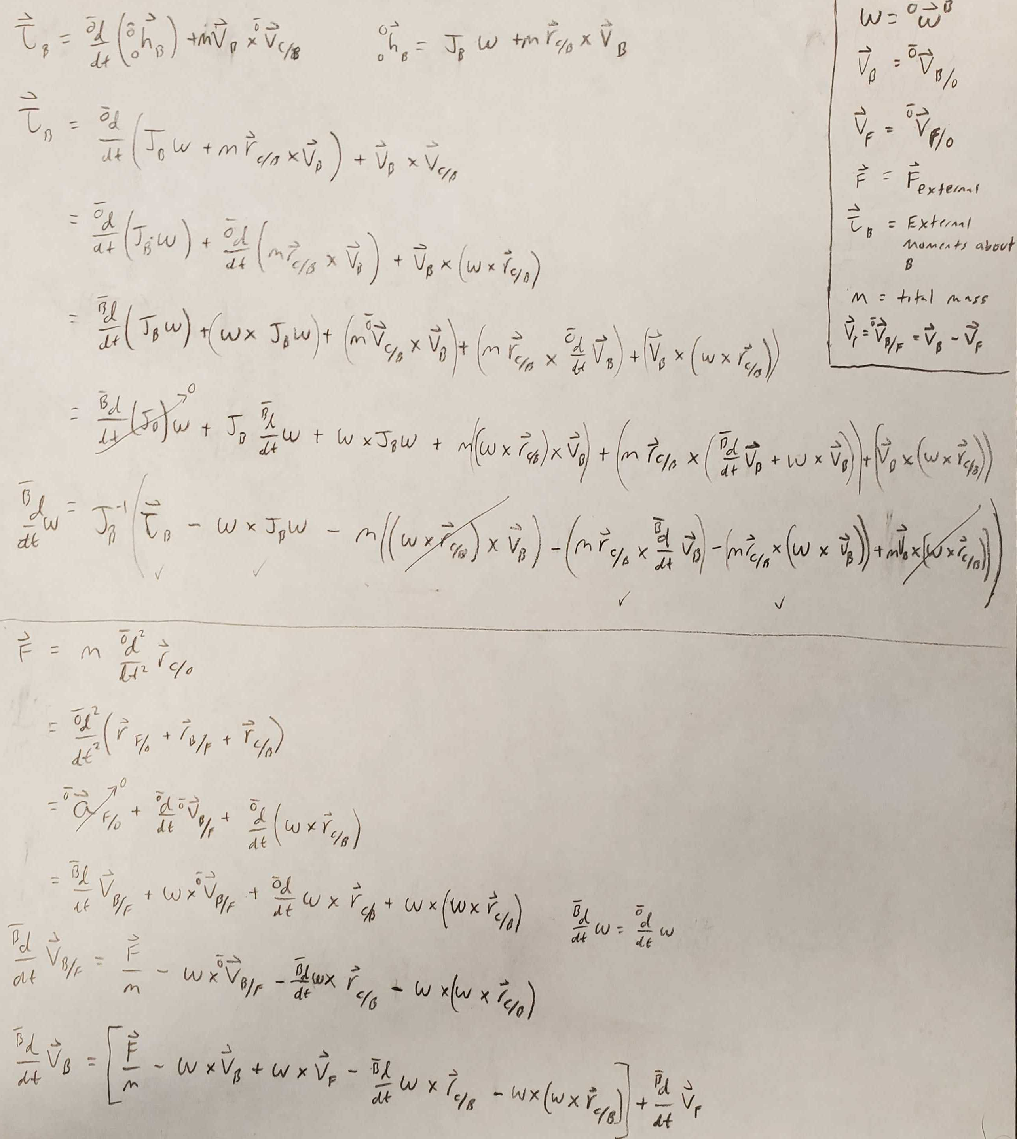
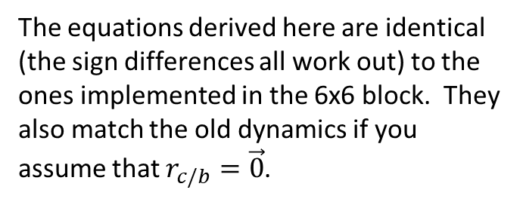
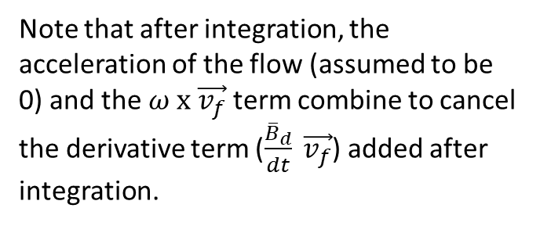
Dynamics as Derived from Basic Equations of Motion
The equations derived here are identical (the sign differences all work out) to the ones implemented in the 6x6 block. They also match the old dynamics if you assume that $r_{c/b}=\vec{0}$.
Note that after integration, the acceleration of the flow (assumed to be 0) and the $ω \text{x} \vec{v_{f}}$ term combine to cancel the derivative term ($\frac{{\overline{B}}_{d}}{dt} \vec{v_{f}}$) added after integration.

Slide 4
Results for 15 seconds of Simulation with a Fixed Time-Step of 1e-4 seconds

Slide 5
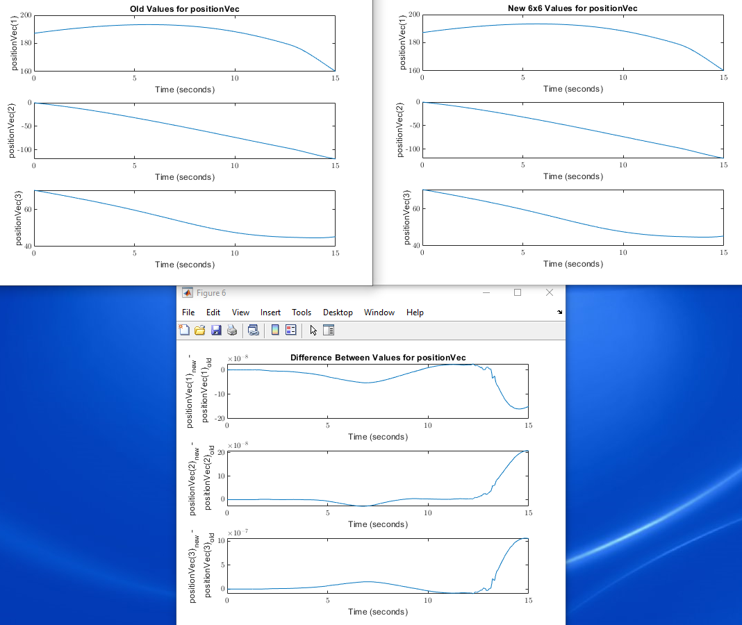

Slide 6
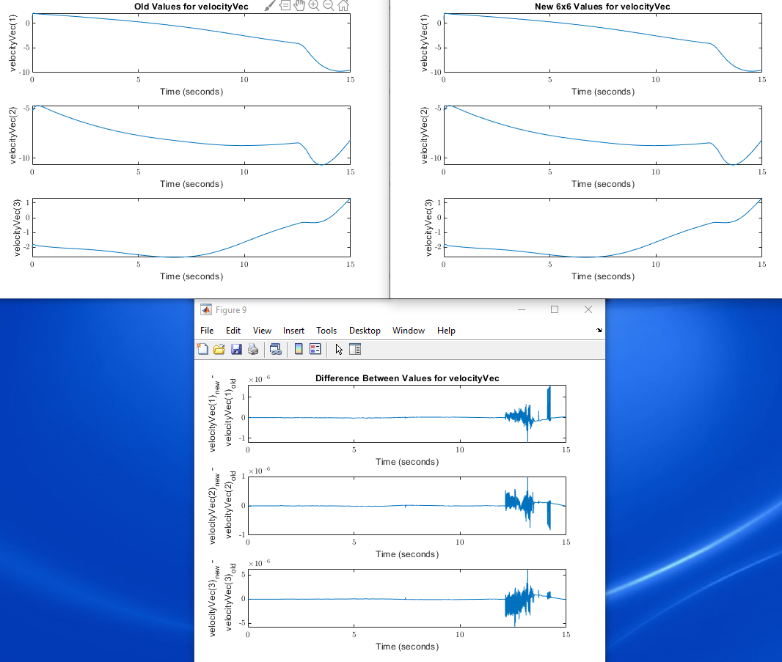

Slide 7
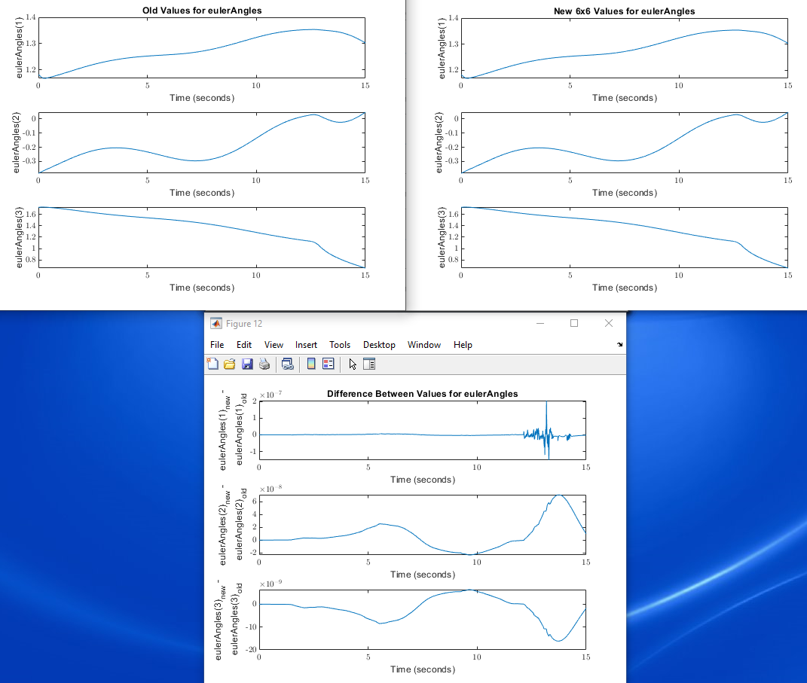

Slide 8
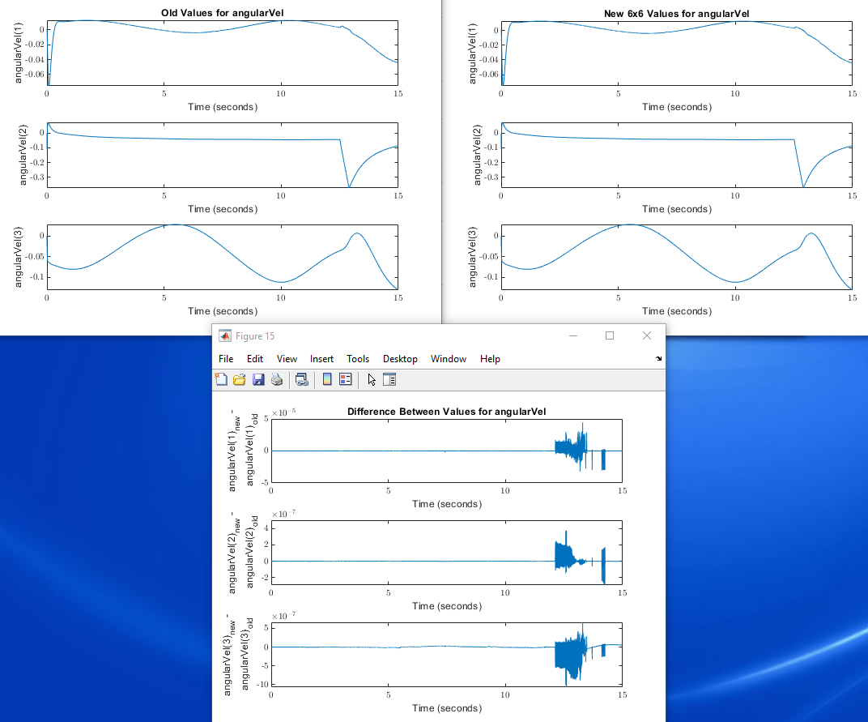

Slide 9
Results for 200 seconds of Simulation with a Variable Time-Step

Slide 10
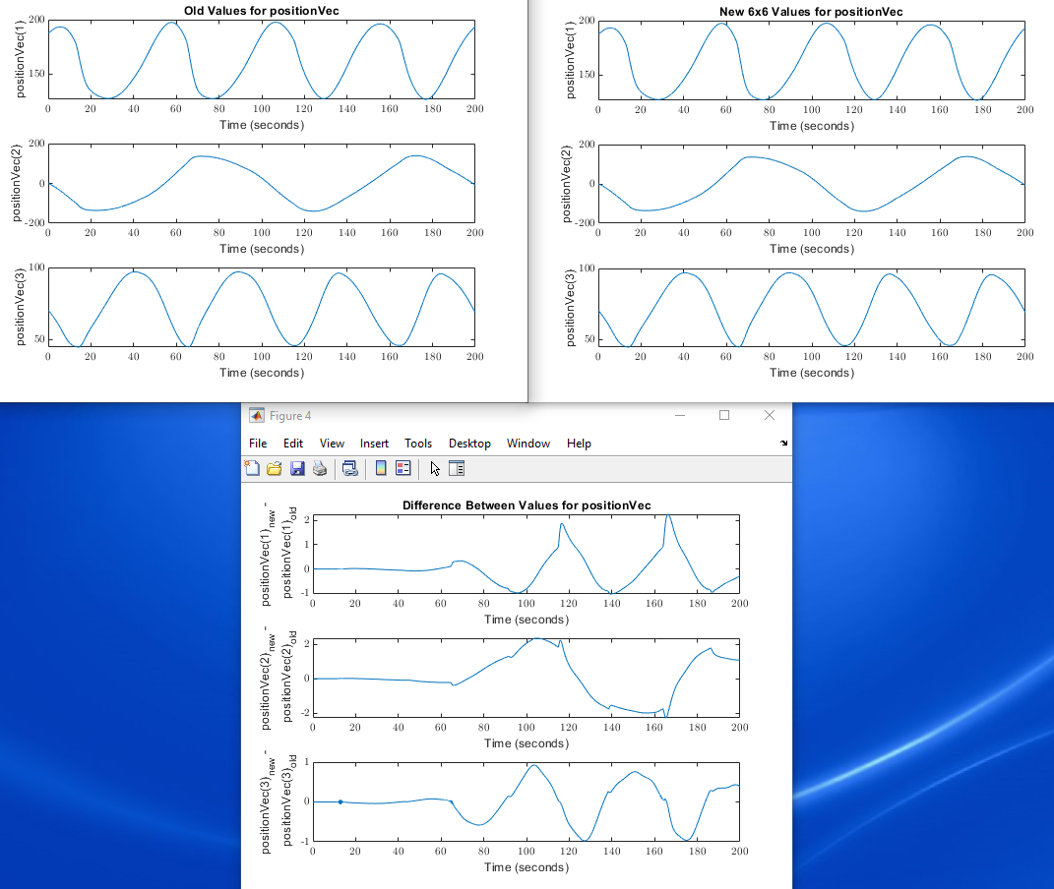

Slide 11


Slide 12
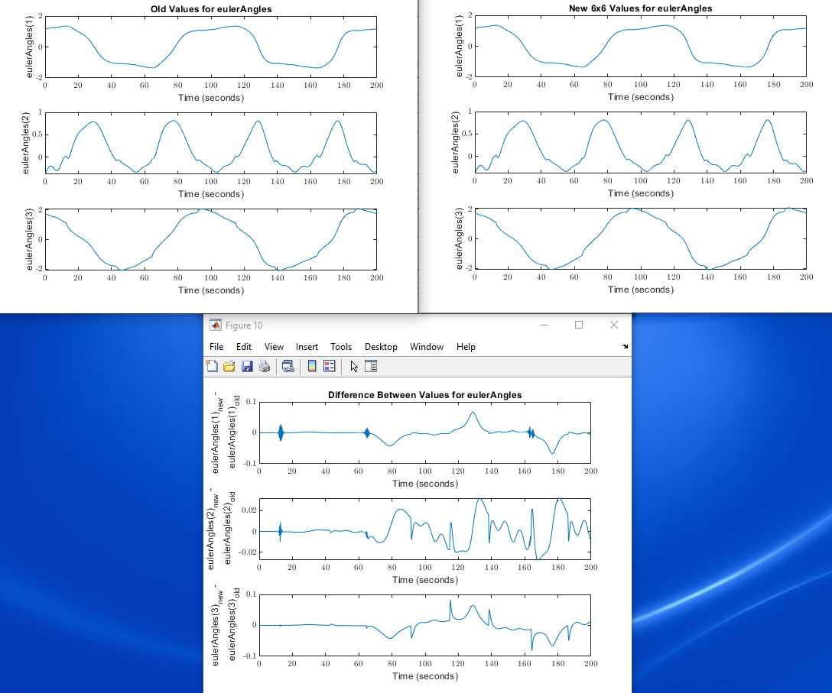

Slide 13
